Slide 1

Postpartum Depression
About Postpartum Depression

Slide 2
About Mental Illness
Mental illness is made up of a diverse composition of medical conditions.
For example, physical trauma, depression, infection, and schizophrenia.
It is characterized by personality disorganization, impaired psychological functioning, and disruption of normal behavior.
Notes:
The event of mental illness is caused by various medical conditions including, depression, trauma, sometimes infection, and schizophrenia. Some of the symptoms include impaired psychological functioning and disruption of what one would refer to normal behavior.

Slide 3

Continuation
Further characterized by impairment of individual abilities including both cognitive and rational.
Caused by various factors including postpartum depression.
Notes:
A individual suffering from mental illness may have their abilities impaired including cognitive and rational abilities. One of the identified causes of mental illness is postpartum depression.

Slide 4
About Postpartum Depression
One of the major causes of mental illness in women.
Associated with various occurrences including miscarriage, childbirth, and the death of a newborn.
Research indicates that it occurs in about 10% of new mothers.
All women are at a potential risk of developing postpartum depression.
Notes:
Postpartum depression is one of the major factors that cause mental illness in women especially new mothers. It occurs in scenarios whereby a woman looses a newborn through death, miscarries, or undergoes childbirth. All women can develop postpartum depression, and about 10% of new mothers develop postpartum depression ().

Slide 5
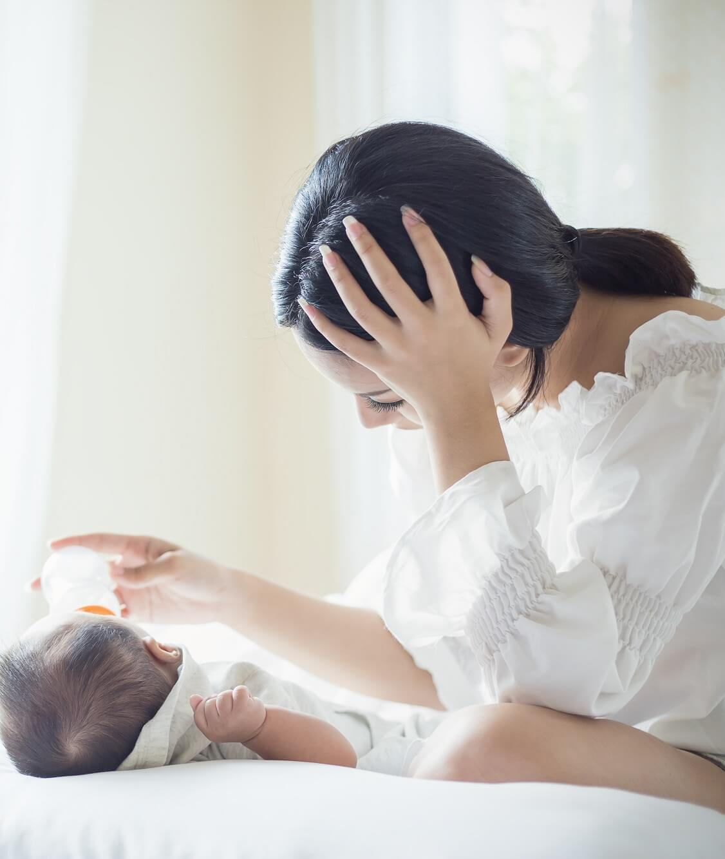
Continuation
The occurrence of postpartum depression may take place a week after the birth of a child, or up to a month after.
The symptoms range from changes in moods, behavior, general body, and also weight.
Notes:
One cannot predict when postpartum depression would occur after the mentioned events associated with childbirth. This is because, it can occur, a week after, or even months later. Some of the most common symptoms include changes in moods, behavior, body weight, and also the overall body.

Slide 6
Continuation
The symptoms may vary from mild to severe which affects the mother-child bonding negatively.
It is characterized by moods including anger, swings, guilt, anxiety, loss of interest among others.
Also characterized by behavioral changes including, crying, and/or restlessness.
Notes:
Depending on the condition of the mother, the symptoms of postpartum depression may vary from mild to severe which then affect the mother-child bonding of the new mothers and their newborns. Some of the mood changes lead to anger, guilt, anxiety, and loss of interest. Behavioral changes include crying and being restless.

Slide 7
Causes of Postpartum Depression
Various causes have been identified to contribute to the development of postpartum depression.
Major causes include a combination of both physical and emotional causes.
In the case of women, they go through strain in the process of delivering a child, including physical and hormonal fluctuations.
Notes:
Postpartum depression is caused by a variety of factors. These causes include both physical and emotional factors. Therefore women who have undergone the mentioned events usually undergo a number of changes both physically and hormonal levels.

Slide 8
Continuation
Studies show that the hormonal changes are speculated to be the causes of postpartum depression in women.
During pregnancy, hormonal levels are usually very high.
After giving birth, they drop drastically which influences the brain due to the caused chemical variations.
It takes a while for these hormones to stabilize.
Notes:
According to Ghaedrahmati et al. (2017), the hormonal changes that occur in women after undergoing childbirth is one of the speculated causes of postpartum depression in women. This occurs since when a women is expectant, their progesterone and estrogen levels are usually high. However, once the baby is born, the hormonal levels drop drastically and it takes time for them to be back to normal.

Slide 9

Continuation
This sudden drop of hormonal levels causes contributes to the physical exhaustion women go through after child birth.
As a result, women end up being sad, angry, and also have appetite changes.
Notes:
Women also go undergo physical exhaustion in the process of childbirth, which is caused by the sudden drop of hormonal levels. The outcomes involve sadness, anger, and not having appetite.

Slide 10
Continuation
Other than hormonal fluctuations, the body also goes through physical strain including sleep deprivation after child birth.
A newborn feeds almost every hour, therefore, the mother’s body should produce enough milk.
A mother spends almost all time awake to be ready to feed the baby, therefore lacking enough sleep.
Notes:
Another cause of postpartum depression physical strain that women undergo after childbirth. An excellent example is sleep deprivation when dealing with a newborn. A newborn requires to feed almost every hour, therefore the mother tries to keep up with the schedule and therefore ends up lacking sleep.

Slide 11
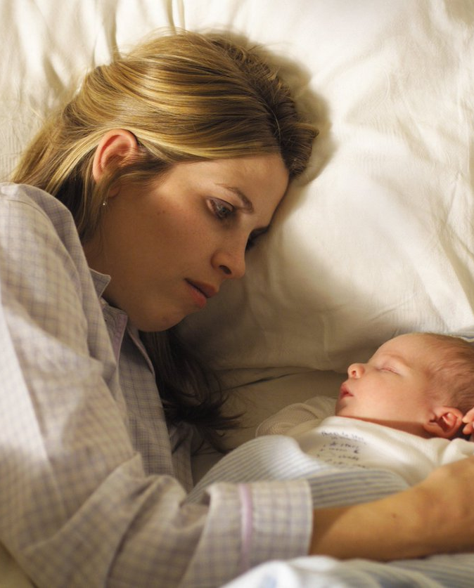
Continuation
Sleep deprivation leads to fatigue causing muscle pains, memory loss and also confusion.
Studies indicate that sleep deprivation is a major contribution to depression.
Notes:
Lacking enough sleep combined with a lot of work results to fatigue which then results to body pain especially in the muscles and memory loss. According to Stewart & Vigod (2016), sleep deprivation is another cause of postpartum depression.

Slide 12
Other Causes
Severe emotional factors can also contribute to the occurrence of postpartum depression.
Taking care of a newborn brings about various emotional factors and continued worry about the baby.
They include, anxiety and the feeling of social separation.
Notes:
Other causes of postpartum depression includes emotional factors such as anxiety and the feeing of social separation. This comes along with the worry when taking care of a newborn.

Slide 13
Continuation
The combination of the hormonal variations, physical changes, and emotional factors, mothers tend to socially isolate themselves.
To some extent some feel like they are not being able to provide for their children as expected.
As a result, many fail to get the needed help due to the feeling of shame.
Notes:
The hormonal variations, physical changes, and emotional factors influence mothers to keep it to themselves and isolate themselves. More so, they end up feeling like they are not providing for their children as expected. As a result, many women end up not seeking professional help which only makes the situation worse.

Slide 14
Continuation
Newborns are delicate at their age, therefore they have a lot of needs.
Mothers tend to focus on providing for the baby and they forget about their needs.
Therefore, they refrain from asking for help due to some of the societal expectations of them.
Notes:
Due to the many needs that newborns usually have, most newborn mothers focus all their time on meeting these needs and fail to concentrate on their personal needs. Also they seclude themselves and avoid interacting with other people while they try to meet some of the societal motherhood expectations (Badr et al., 2018).

Slide 15

Continuation
As a result mothers feel loneliness, guilt, and inadequacy.
The overwhelming feelings leads to depression.
Notes:
All these factors combined result to postpartum depression which requires treatment to avoid severe conditions.

Slide 16
Conclusion
To reduce the occurrence of mental illness among new mother, maternity hospitals should offer training to new mothers before discharging them.
Research indicates that over 600,000 women have been affected by postpartum depression.
Therefore, a lot is needed to be implemented to improve new mother’s health.
Notes:
In conclusion, postpartum depression should be prevented, more so, since according to Ghaedrahmati et al. (2017), about 600,000 women develop postpartum depression. Maternity hospitals could mitigate this healthcare problem through the incorporation of teaching on the topic to new mothers before they are discharged from hospital.

Slide 17
References
Badr, L. K., Ayvazian, N., Lameh, S., & Charafeddine, L. (2018). Is the effect of postpartum depression on mother-infant bonding universal?. Infant Behavior and Development, 51, 15-23.
Ghaedrahmati, M., Kazemi, A., Kheirabadi, G., Ebrahimi, A., & Bahrami, M. (2017). Postpartum depression risk factors: A narrative review. Journal of education and health promotion, 6.
Stewart, D. E., & Vigod, S. (2016). Postpartum depression. New England Journal of Medicine, 375(22), 2177-2186.

